Slide 1

Plant Disease Detection
Marthe Elgawly 2170201
Beyza Nur Elaslan 2180876
Melissa Almeida 2179438
Oleksandra Panibratets 2187414
Riccardo Capobianco 1884636
Foundations of Data Science
Notes:
Line spacing + Page numbers

Slide 2
Agenda
01 Task and Motivation
02 Models and Tools
03 Analysis

Slide 3
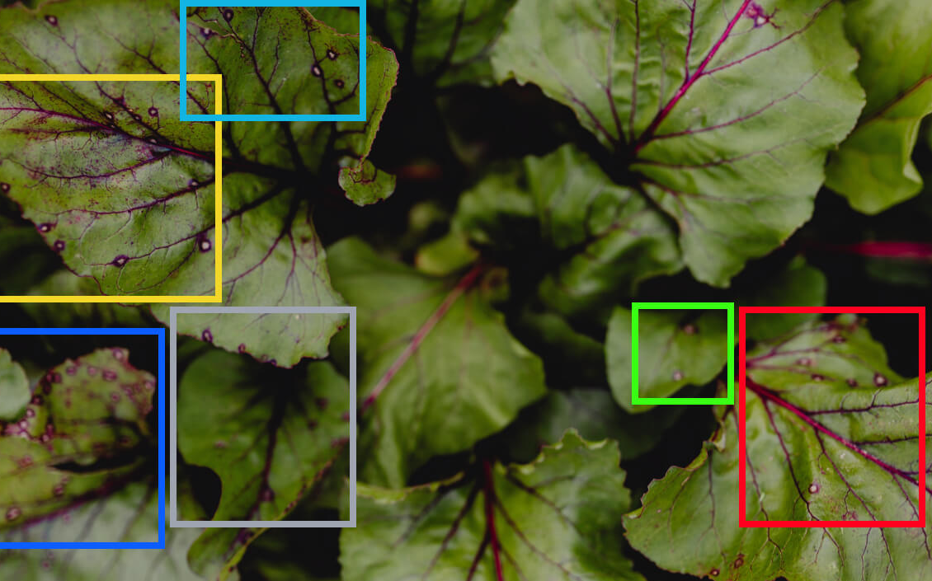

Task and Motivation
01
up to 40 percent of global crop production is lost due to plant diseases[2]
Goal: Determine the types of diseases affecting a variety of plants to enable early detection
Impact: Why is this important?
Food Security: Healthy crops
Environmental Protection: Minimize use of pesticides
Economic Benefits: Reduction of loss for farmers caused by diseases.
Sustainability: Less produce is wasted

Slide 4
Models and Tools
02
Using the Plant Disease dataset[3] (approximately 87,000 labeled images across multiple classes), the goal of the model is to identify and classify the type of disease affecting a plant based on its input image.
Techniques:
Image Preprocessing: Standardize image size and normalize pixel values.
Feature Extraction: Examine texture, color variations, and patterns on leaves.
Convolutional Neural Networks (CNNs): Identify and localize disease-specific symptoms on plant leaves.
Workflow:
Input: Unprocessed images of both healthy and diseased plants.
Output: Disease classification into one of 38 categories.

Slide 5
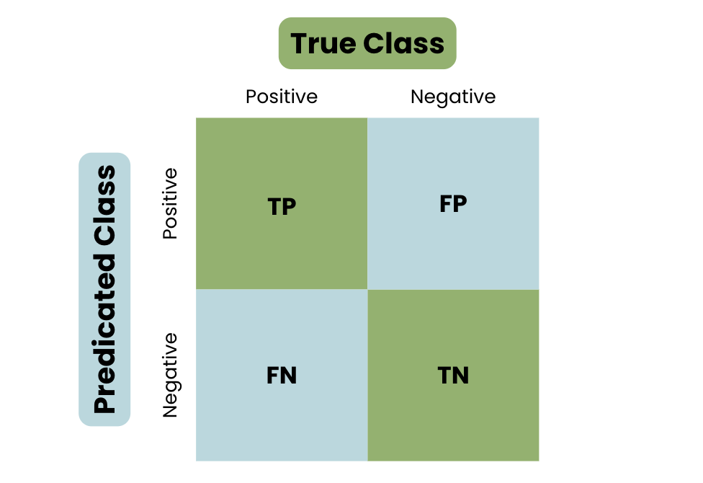
Analysis
03
The evaluation of the model will be conducted using a test dataset[3] of images. To assess the model's performance, we will utilize specific performance metrics that we have learned during our course, along with additional relevant measures. These metrics include:
Accuracy (%): (TP + TN) / (P + N)
Recall (%): TP / (TP + FN)
Confusion Matrix: A summary table that displays the counts of TP, TN, FP and FN

Slide 6
Thank you
04
Resources:
[1] Paper : Islam, Md. Tariqul. (2022). Plant Disease Detection using CNN Model and Image Processing.
[2] FAO’s Plant Production and Protection Division
[3] Dataset: https://www.kaggle.com/datasets/vipoooool/new-plant-diseases-dataset/data

